Slide 1
Network economics: the hardware/software paradigm, winner-takes-all-markets and technological standard wars_5
Luca Grilli
L. Grilli, Politecnico di Milano –Network economics

Slide 2
Final thought(s)

Slide 3
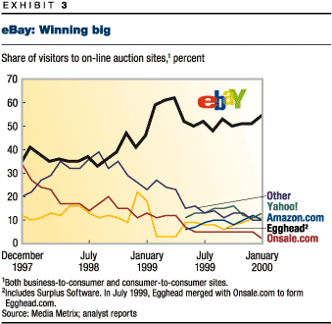
Always keeping in mind caveats and exceptions (e.g. community of interest, local nature of network externalities, multi-homing phenomena), we know that the choice of “non compatibility” (“standard wars”) can frequently lead to global monopolies
Thus, if WINNER TAKES ALL MARKET!!!!!!!
What the LOSERS can do?

Slide 4
But nothing is everlasting!!!!!!!....or is it?
In network markets competition and rivalry could not be within the market but rather be for the market. Monopoly can only be temporary, and they can always be interrupted by technological breakthroughs (Schumpeterian competition, SM1). If this is the case, market shares can be a poor indicator of the degree of competition and rivalry that exist in a network market.
But…Network monopolies are (probably) becoming more stable than in the recent past……….See GAFAM (or MAAMA) in digital markets.
Why?
-Network monopolies are now conglomerates with enormous advantages (financial resources but also data) and they are persistent top investors in R&D (SM2).
(see Daiko T., Dernis H., Dosso M., Gkotsis P., Squicciarini M., Vezzani A. (2017). World Corporate Top R&D Investors: Industrial Property Strategies in the Digital Economy. A JRC and OECD common report. Luxembourg: Publications Office of the European Union; Grassano, N., Hernandez Guevara, H., Fako, P., Tübke, A., Amoroso, S., Georgakaki, A., Napolitano, L., Pasimeni, F.,Rentocchini, F., Compaño, R., Fatica, S. and Panzica, R. The 2021 EU Industrial R&D Investment Scoreboard, EUR 30902 EN, Publications Office of the European Union, Luxembourg, 2021, ISBN 978-92-76-44399-5, doi:10.2760/559391, JRC127360)
-The narrative of a successful entrepreneur is now the one who “exits” by selling its business to an incumbent (lack of SM1).
- Large (Killer?) acquisitions of start-ups made by large incumbents.
(Cunningham, C., Ederer, F., & Ma, S. (2021). Killer acquisitions. Journal of Political Economy, 129(3), 649-702).

Slide 5
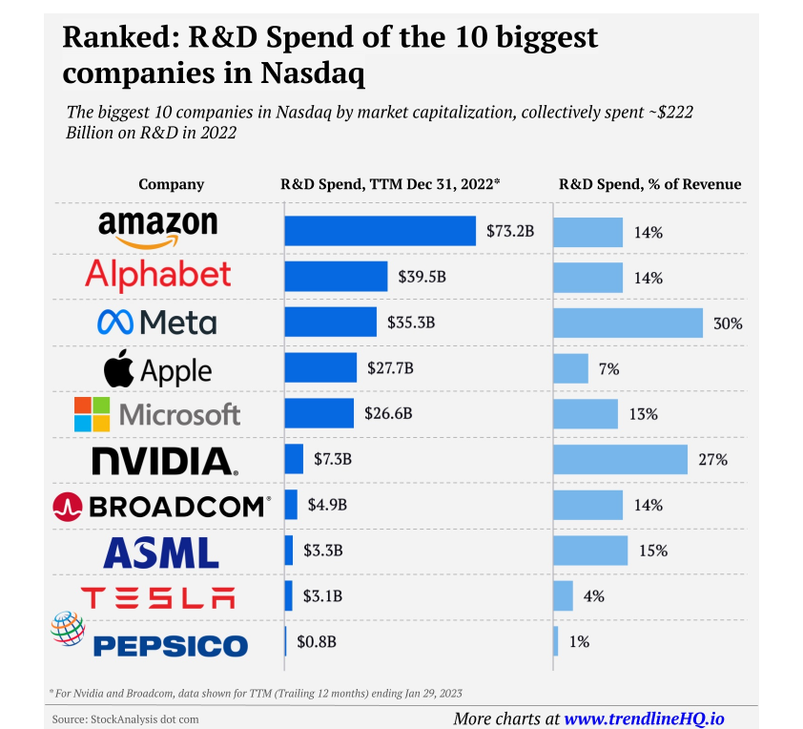

Slide 6
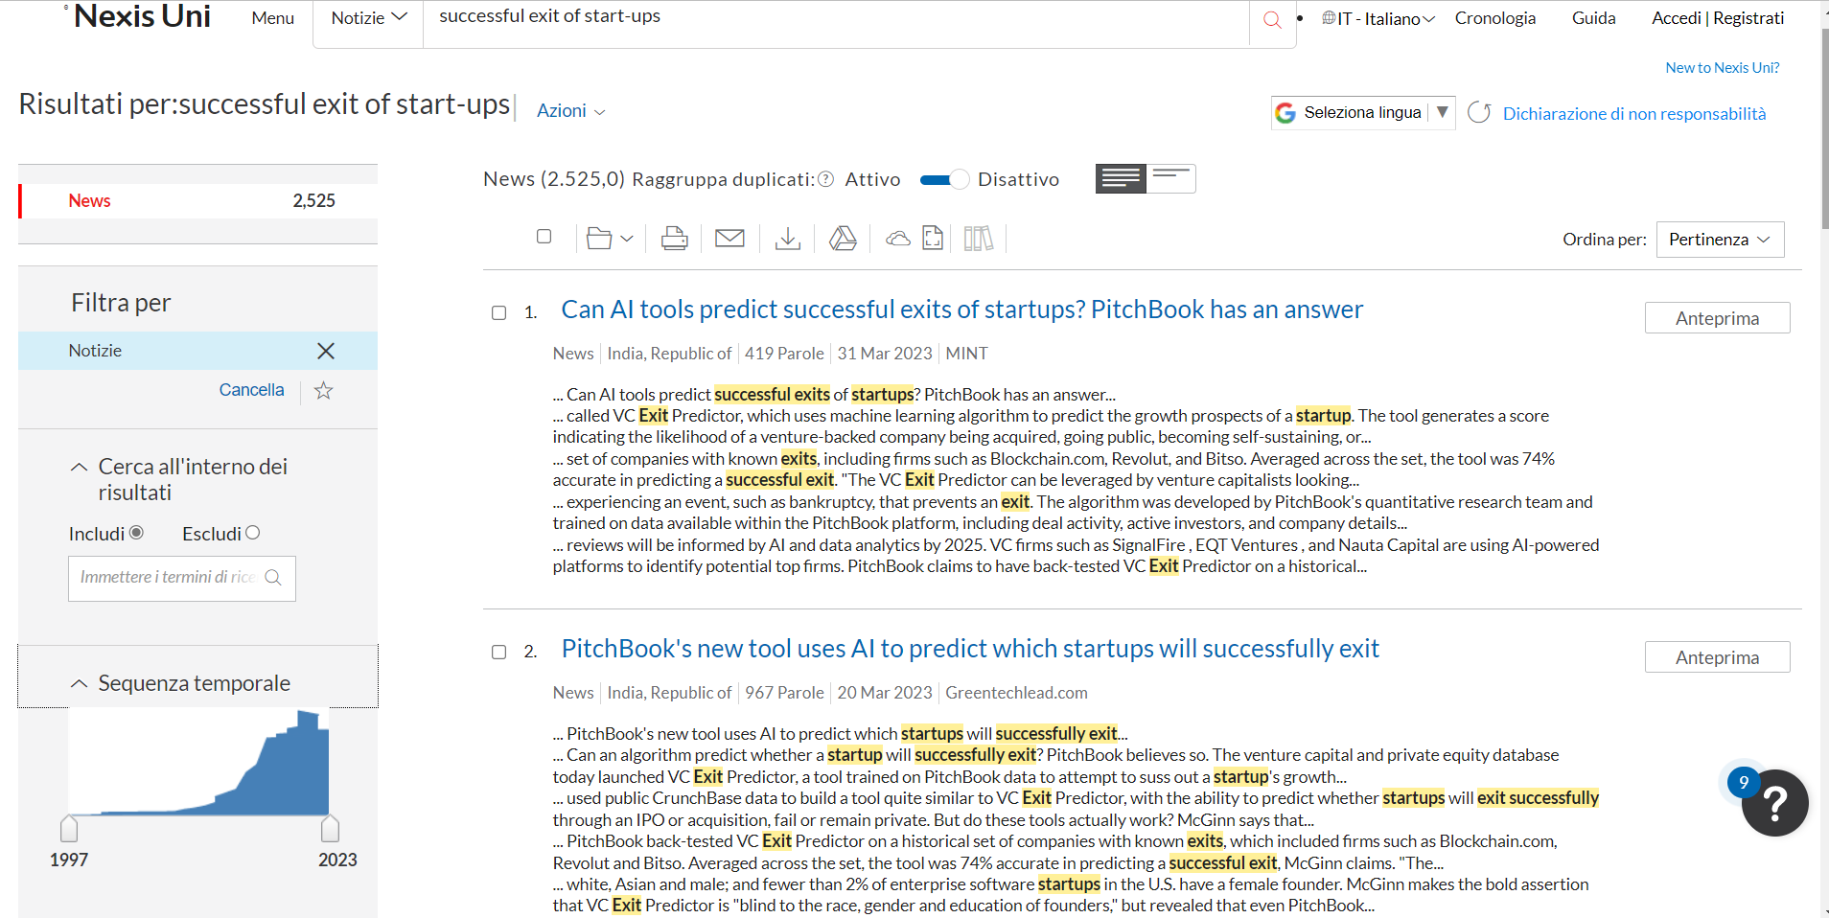
From “Private Kingdom” to “Take the Money and Run”?

Slide 7
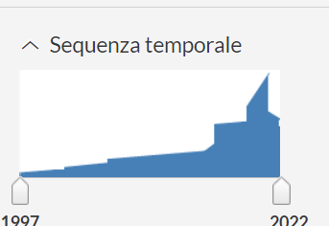
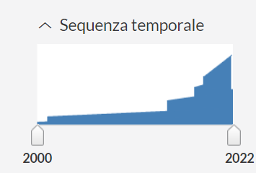
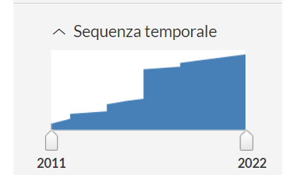
“Successful exit of start-ups” translated in different languages (source: Nexis-Uni)
French
German
Italian

Slide 8
Source: Atomico 2016
“Google parent Alphabet’s 22 deals, Microsoft’s 56 deals and Amazon’s 29 deals in 2021 were all 10-year highs” (CBNC, Sherman & Feiner, 22 Jan 2022, Amazon, Microsoft, Alphabet set more deals in 2021 than last 10 years (cnbc.com))

Slide 9
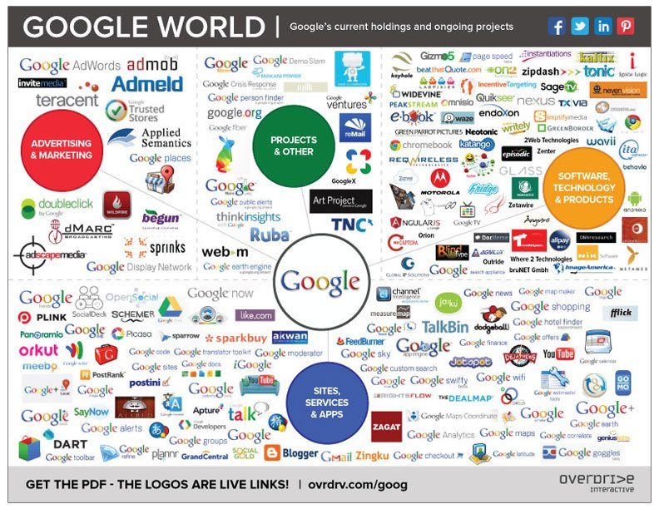
Google (Alphabet) has bought almost 1 firm per month.
Approximately since its inception (1998), Google has bought c.a. 260 start-ups over 25 years.

Slide 10

Incumbent: be always on guard!!!!!!
The Microsoft case is emblematic of the fact that a monopolist in a network market can not relax and need to be always on its guard.
The browser war in the mid ’90s

Slide 11
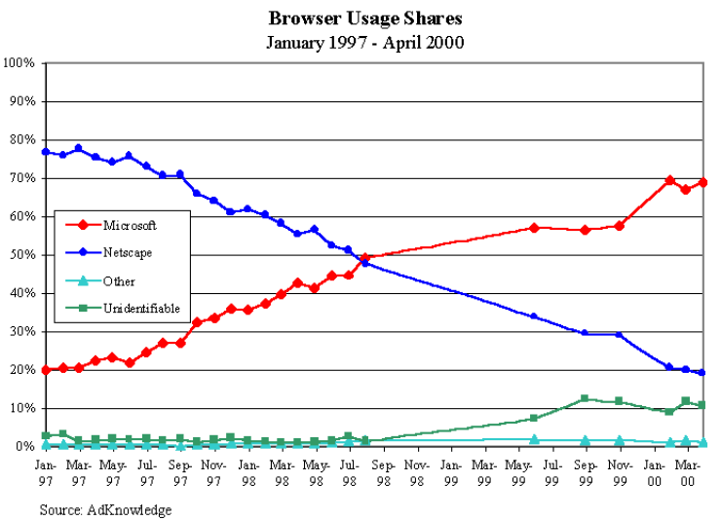

Slide 12
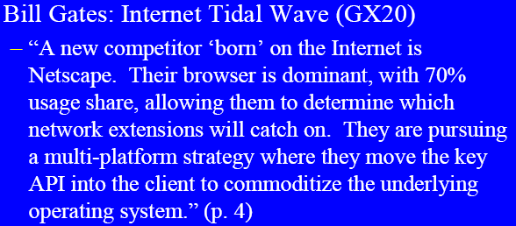
Bill Gates precognized the risk of OS commoditization

Slide 13
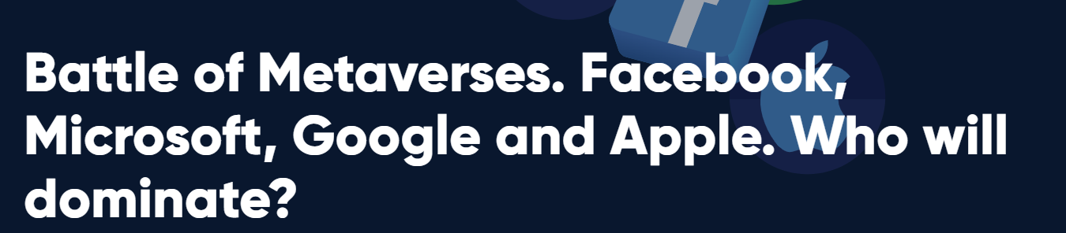

New challenges & (futuristic) open questions
AI wars (Chat GPT/GPT-4 Open AI & Microsoft copilot vs. Google Gemini; etc.)
Voice Virtual Assistance: Hey Google vs. Alexa vs. Siri
Metaverse: Will metaverse (or similar) succeed?
How many metaverses will we have?

Slide 14
ESSENTIAL REFERENCES
(for all lectures on network economics)
L. Cabral, Introduction to Industrial organization, I edition, 2000, Chapter 16.
J. H. Rohlfs, 2001, Bandwagon effects in high-technology industries, MIT, Boston, Chapters 3,4,5.
Additional:
C. Shapiro e H. R. Varian, 1999, Information rules, ETAS Libri
Peter Grindley, 1995, Standards, Strategy, and Policy,Cases and Stories, Oxford University Press.
L. Cabral, Introduction to Industrial organization, II edition, 2018, Chapter 16.

